Slide 1
Ancient Greek for Everyone: A New Digital Resource for Beginning Greek Unit 6: Prepositions
2015 edition
Wilfred E. Major
wmajor@lsu.edu

Slide 2
Ancient Greek for Everyone
AGE Unit 6: Greek Prepositions
Prepositions in Greek for the most part work as they do in English. The principal difference is that the meaning and usage of a preposition change somewhat depending on the case of the noun.
Remember that the four cases in Greek give a basic idea of how a noun functions in a sentence.
Prepositions make the case usage more specific.
Notes:
http://www.youtube.com/watch?v=ITXrRHBA5OM - Schoolhouse Rock: Grammar Rock: Prepositions
Posted in YouTube multiple times

Slide 3
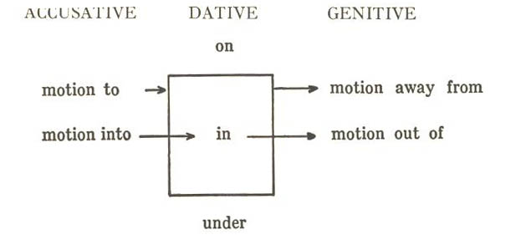
Ancient Greek for Everyone
Greek Prepositions
Greek prepositions require their nouns to be in specific cases. Prepositions govern nouns in the genitive, dative or accusative cases.
Greek prepositions at their root often indicate direction. This chart shows the directions that each case generally indicates:

Slide 4
Ancient Greek for Everyone
Greek Prepositions
Three prepositions illustrate this dynamic:
εἰς + acc. “into” ἐν + dat. “in” ἐκ + gen. “out of”

Slide 5
Ancient Greek for Everyone
Greek Prepositions
These prepositions normally do not bear an accent.
εἰς + acc. “into” εἰς τὸ στόμα “into the mouth”
εἰς can be shortened to ἐς: ἐς τὸ στόμα “into the mouth”
ἐν + dat. “in” ἐν τῷ στόματι “in the mouth”
ἐκ + gen. “out of” ἐκ τοῦ στόματος “out of the mouth”
but before a vowel, ἐκ becomes ἐξ:
ἐξ αἵματος “out of blood”

Slide 6
Ancient Greek for Everyone
ἀμφί, ἀμφ’ around
ἀνά, ἀν’ up
ἀντί, ἀντ’/ἀνθ’ back
ἀπό, ἀπ’/ἀφ’ from
διά, δι’ through
ἐπί, ἐπ’/ἐφ’ on
κατά, κατ’/καθ’ down
μετά, μετ’/μεθ’ with, after
παρά, παρ’ beside
περί about
πρό before
ὑπό, ὑπ’/ὑφ’ under
All other prepositions normally accent their final syllable.
Spell it like it sounds! Prepositions frequently drop their final vowel before a word beginning with a vowel (except περί and πρό).

Slide 7
Ancient Greek for Everyone
Greek Prepositions
Prepositions normally accent their final syllable:
ἀπὸ τοῦ στόματος “from the mouth”
On rare occasions, if they have an accent on their first syllable, then the object of the preposition comes before the preposition:
τοῦ στόματος ἄπο “from the mouth”
Spell it like it sounds! Prepositions frequently drop their final vowel before a word beginning with a vowel:
ἀπὸ τῆς ἐλπίδος “from the hope”
ἀπ’ ἐλπίδος “from hope”

Slide 8
Ancient Greek for Everyone
ἀμφί, ἀμφ’ around
ἀντί, ἀντ’/ἀνθ’ back
ἀπό, ἀπ’/ἀφ’ from
ἐπί, ἐπ’/ἐφ’ on
κατά, κατ’/καθ’ down
μετά, μετ’/μεθ’ with, after
ὑπό, ὑπ’/ὑφ’ under
Spell it like it sounds! After a preposition drops its final vowel, the remaining consonant can merge with a rough breathing:
ἀπὸ τοῦ αἵματος “from the blood” ➔ ἀφ’ αἵματος “from blood”

Slide 9
Ancient Greek for Everyone
ἀμφί, ἀμφ’ around
ἀνά, ἀν’ up
διά, δι’ through
εἰς/ἐς into
ἐπί, ἐπ’/ἐφ’ against
κατά, κατ’/καθ’ down, according to, throughout
μετά, μετ’/μεθ’ after
παρά, παρ’ toward
περί about
πρός to
ὑπέρ above
ὑπό, ὑπ’/ὑφ’ under
prepositions with nouns in the accusative case

Slide 10
Ancient Greek for Everyone
ἐν in
ἐπί, ἐπ’/ἐφ’ on
παρά, παρ’ beside
περί about
πρός to
σύν with
prepositions with nouns in the dative case

Slide 11
Ancient Greek for Everyone
ἀντί, ἀντ’/ἀνθ’ opposite
ἀπό, ἀπ’/ἀφ’ from
διά, δι’ through
ἐκ, ἐξ from
ἐπί, ἐπ’/ἐφ’ on
κατά, κατ’/καθ’ down
μετά, μετ’/μεθ’ with
παρά, παρ’ beside
περί about
πρό before
πρός to
ὑπέρ over
ὑπό, ὑπ’/ὑφ’ under, by
prepositions with nouns in the genitive case

Slide 12
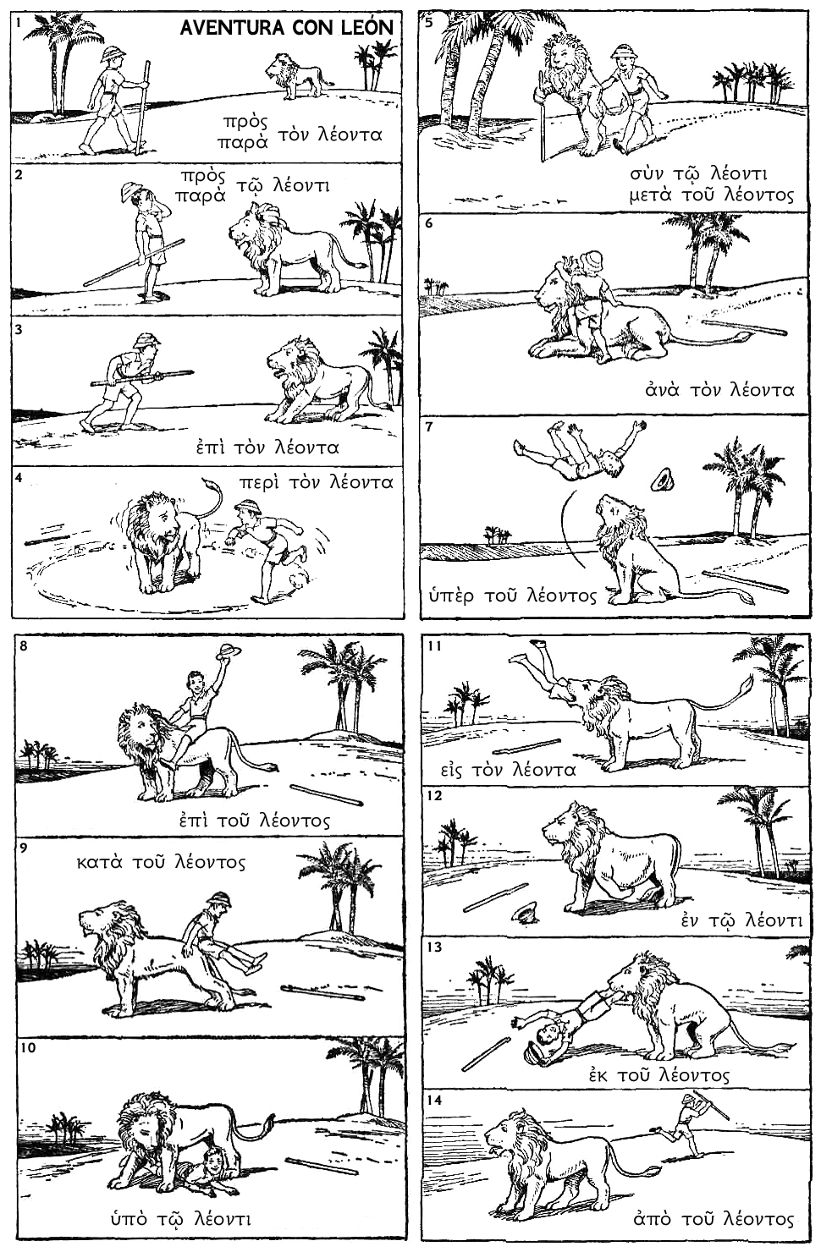
Notes:
http://www.uncg.edu/cla/LionPrepGrk.html

Slide 13
Notes:
http://www.uncg.edu/cla/LionPrepGrk.html

Slide 14
Ancient Greek for Everyone
prepositions without a lion
ἀμφί around
ἀντί opposite
διά through
πρό before

Slide 15
Ancient Greek for Everyone
ἀμφί, ἀμφ’ around
ἀνά, ἀν’ up
ἀντί, ἀντ’, ἀνθ’ opposite
ἀπό, ἀπ’, ἀφ’ from
διά, δι’ through
εἰς into
ἐκ, ἐξ out of
ἐν, ἐγ-, ἐμ- in
ἐπί, ἐπ’, ἐφ’ on
κατά, κατ’, καθ’ down
μετά, μετ’, μεθ’ with, after
παρά, παρ’ beside
περί about
πρό (ο can contract) before
πρός to
σύν, συγ-, συμ-, συλ- with
ὑπέρ above
ὑπό, ὑπ’, ὑφ’ under
Prepositions often double as prefixes for verbs.
When they are attached to verbs, their final vowels can drop
and/or the adjacent consonant assimilates to the first sound of the verb.

Slide 16
Ancient Greek for Everyone
Building a Greek verb
Some verbs in the vocabulary from Unit 2 have prefixes:
ἀνίστημι (ἀνα + ἵστημι) raise, appoint
ἀποδίδωμι (ἀπο + δίδωμι) give back
ἀφίημι (ἀπο + ἵημι) let go, allow, forgive
ἐπιτίθημι (ἐπι + τίθημι) put on
καθίστημι (κατα + ἵστημι) set down, establish
παραδίδωμι (παρα + δίδωμι) hand over, deliver
πάρειμι (παρα + εἰμί) be present
παρίστημι (παρα + ἵστημι) present
προστίθημι (προς + τίθημι) add το

Slide 17
Ancient Greek for Everyone Unit 6 Vocabulary: Classical
ἀμφί around
ἀνά up
ἀντί opposite
ἀπό from
διά through
εἰς into
ἐκ, ἐξ out of
ἐν in
ἐπί οn
κατά down
μετά with, after
παρά beside
περί about
πρό before
πρός to
σύν with
ὑπέρ above
ὑπό under

Slide 18
Ancient Greek for Everyone Unit 6 Vocabulary: NT
ἄχρι(ς) until
ἀπό from
διά through
εἰς into
ἐκ, ἐξ out of
ἐν in
ἐπί οn
κατά down
μετά with, after
παρά beside
περί about
πρό before
πρός to
σύν with
ὑπέρ above
ὑπό under

Slide 19
Notes:
Kenneth Berding. Sing and Learn New Testament Greek (Zondervan, 2008). Does not include ἀμφί or ἀνά

Slide 20
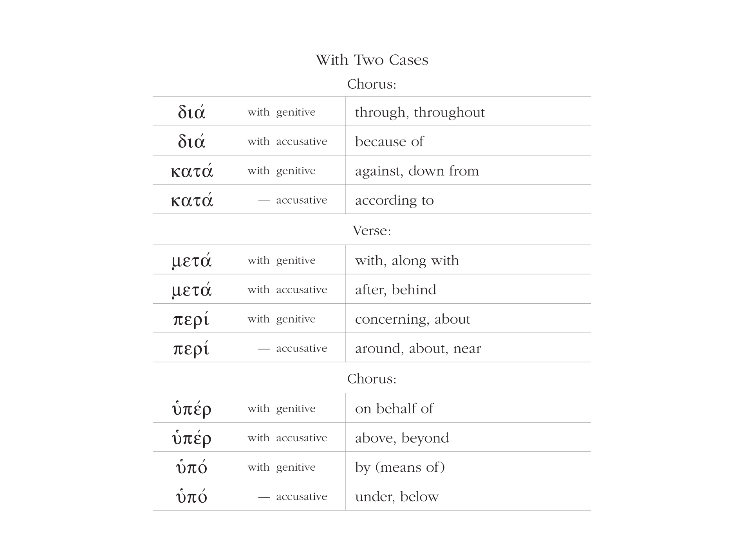
Notes:
Kenneth Berding. Sing and Learn New Testament Greek (Zondervan, 2008). Does not include ἀμφί or ἀνά

Slide 21
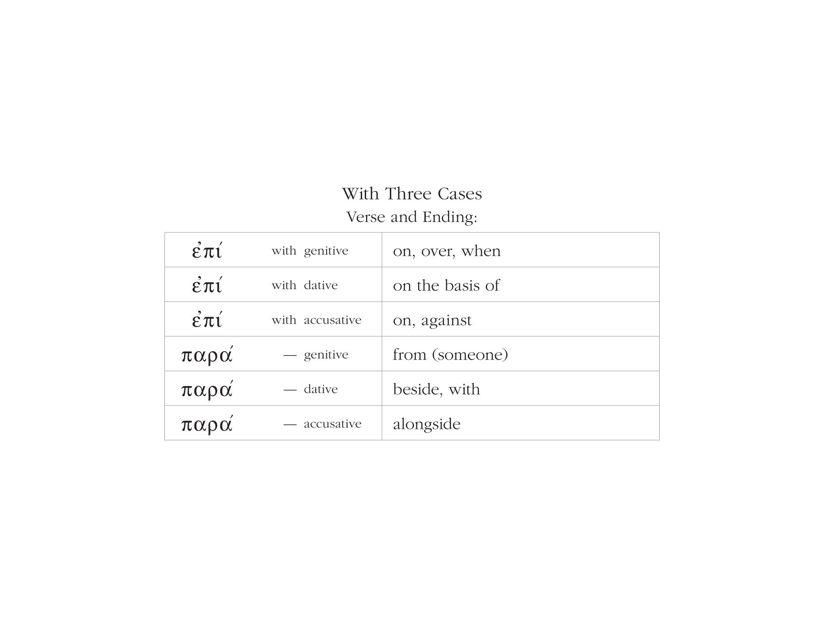
Notes:
Kenneth Berding. Sing and Learn New Testament Greek (Zondervan, 2008). Does not include ἀμφί or ἀνά

